Slide 1
ASL Translator
by
Abhishek Vangipuram
Eugene Mondkar
Juan Ceja
Tai-Wei Chien

Slide 2
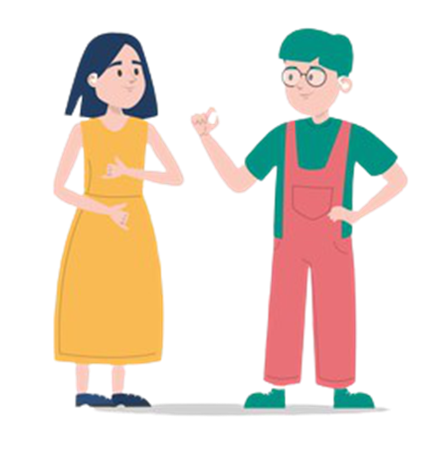
What is ASL Translator ?
ASL is abbreviated as “American Sign Language” which uses hand signs, facial expressions to communicate ideas.
Most people do not understand sign language, especially those who are not deaf. Hence this ASL translator converts ASL to text so that non ASL speakers can communicate easily with ASL speakers.

Slide 3
Introduction
Main problem is that of visually recognizing specific hand gestures that match the official hand gestures of ASL.
An alphabet translation model is the most important component to accomplish the task.
A robust CNN model is used as the core pre-processor in our system.
We have used 4 different data sets. Our training data consists of 57K images with a resolution of 200X200 pixels. Our test data set is a combination of 3 different data sets which we got from Kaggle.com, it contains 14430 images data.
The other 3 data sets have been used for testing and evaluation.
.

Slide 4
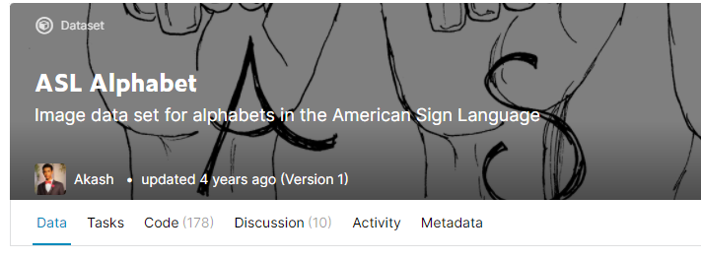
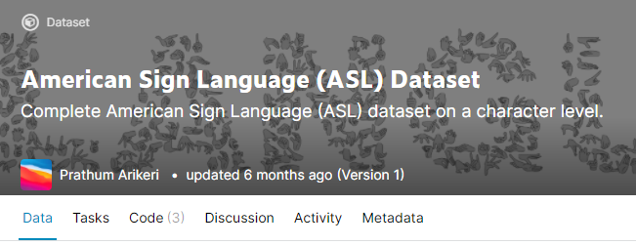
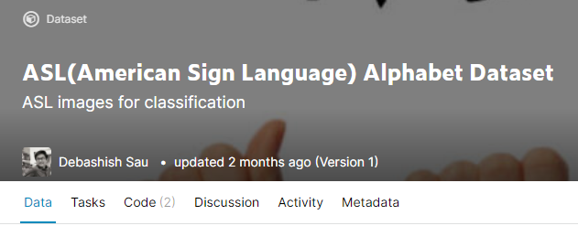
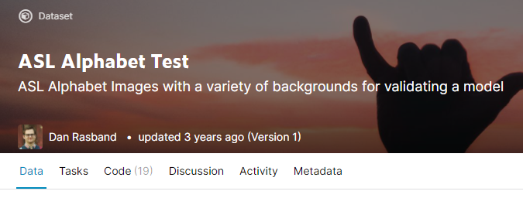
Data sets
We used four different data sets which we got from https://www.kaggle.com/
In total we had around 450k images available for us to use in our project. We used a relatively small subset of all this images in our project.
Our training data set has around 52k images and our testing data set has around 14.5k images.

Slide 5
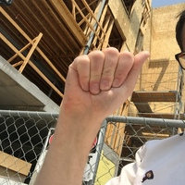
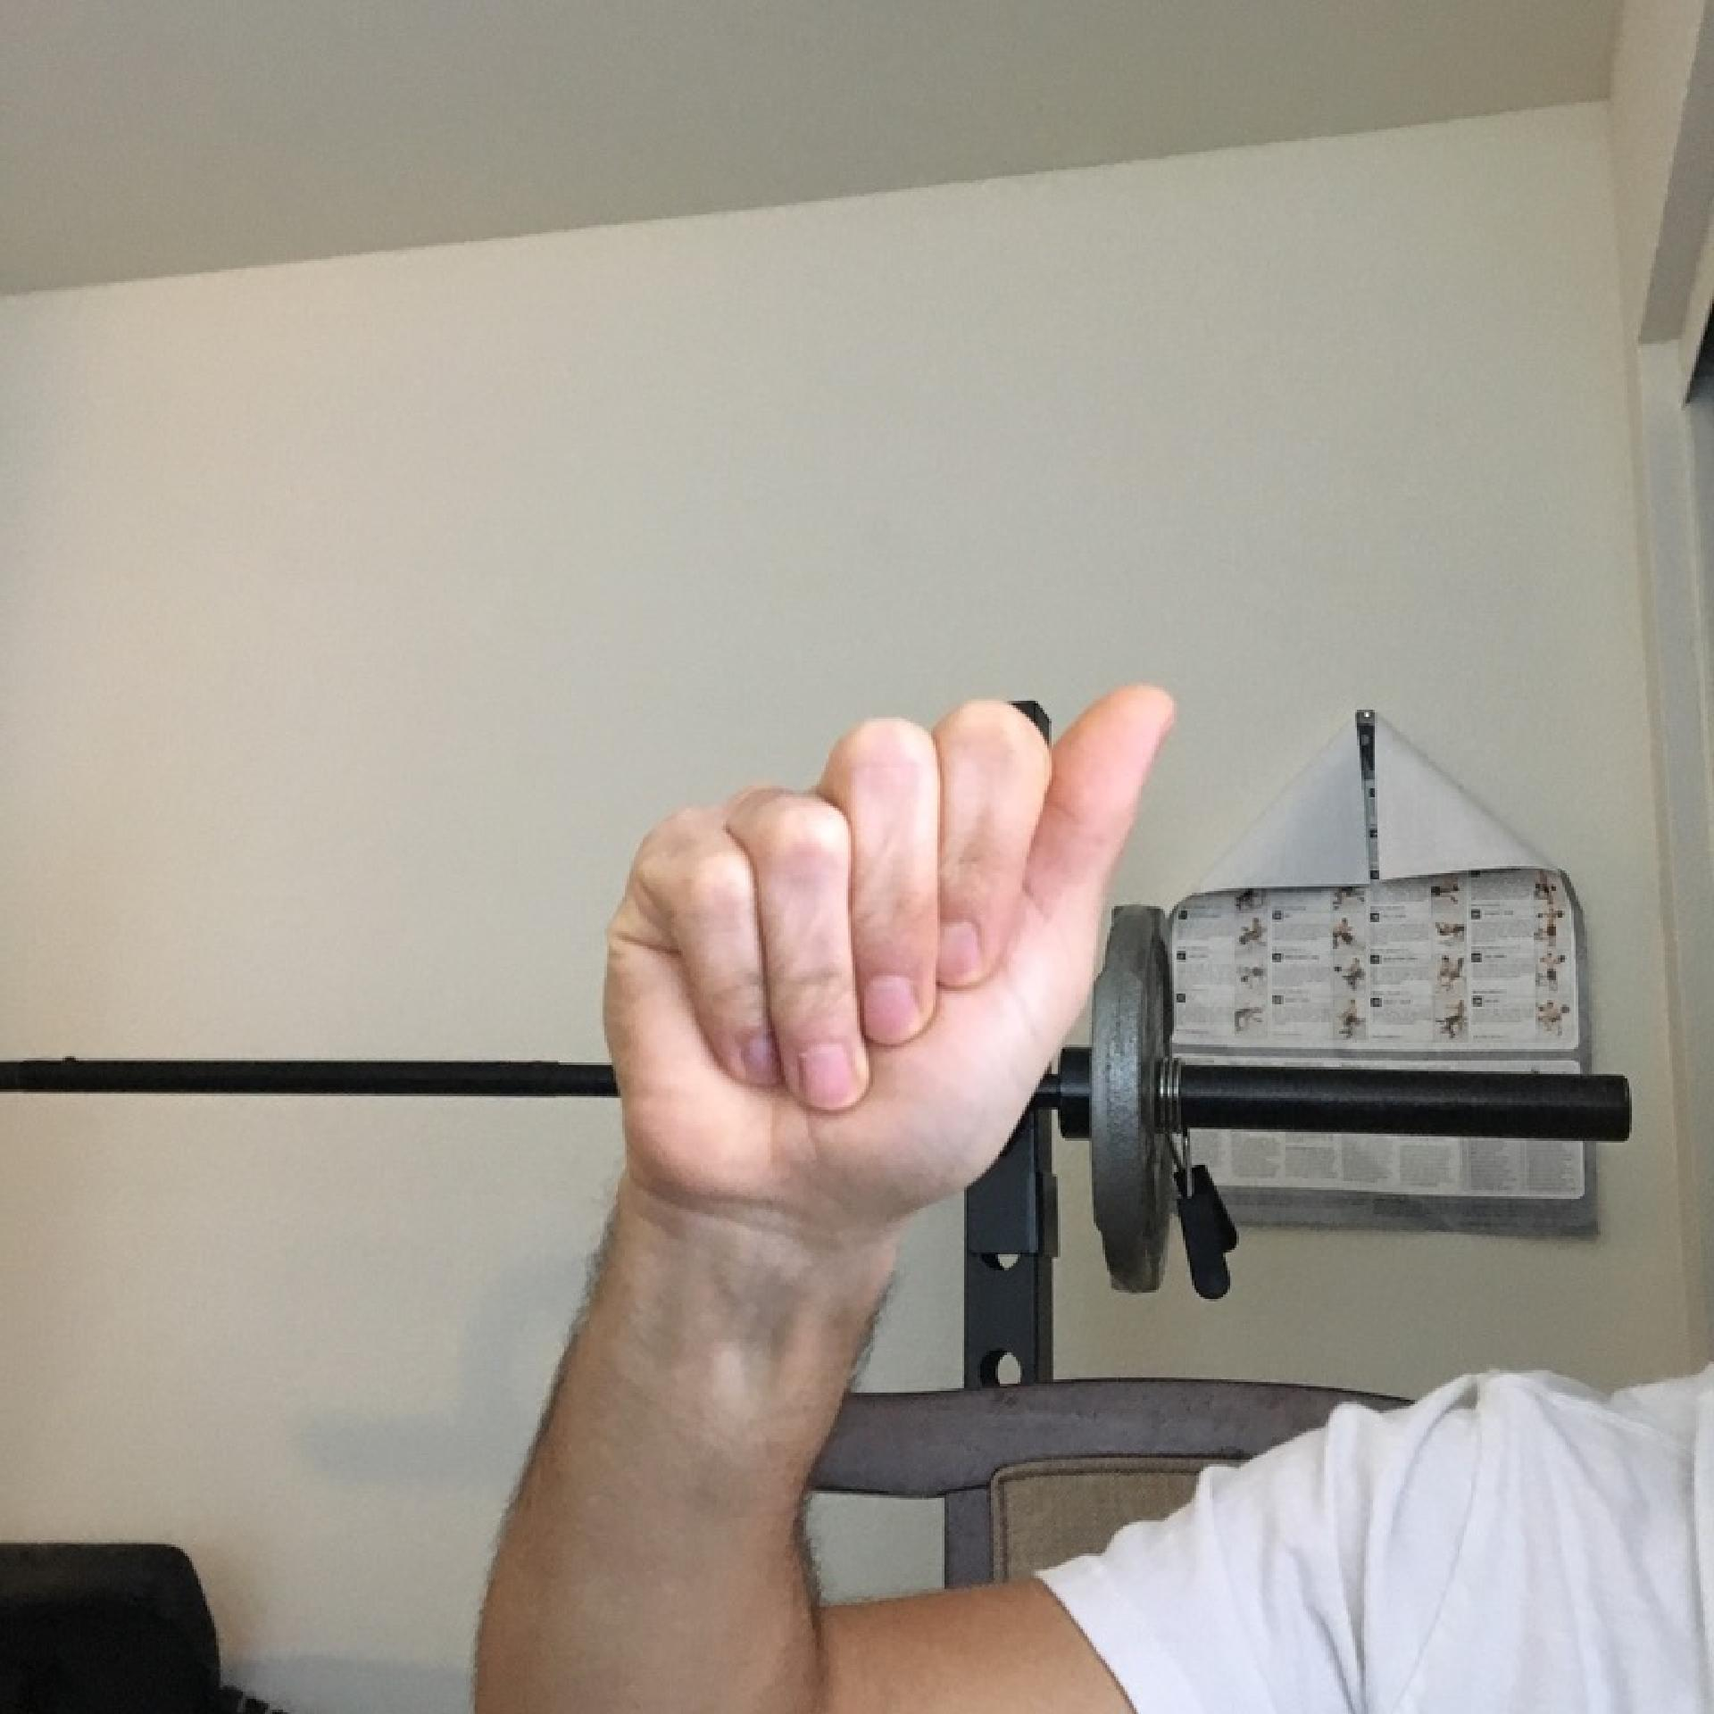
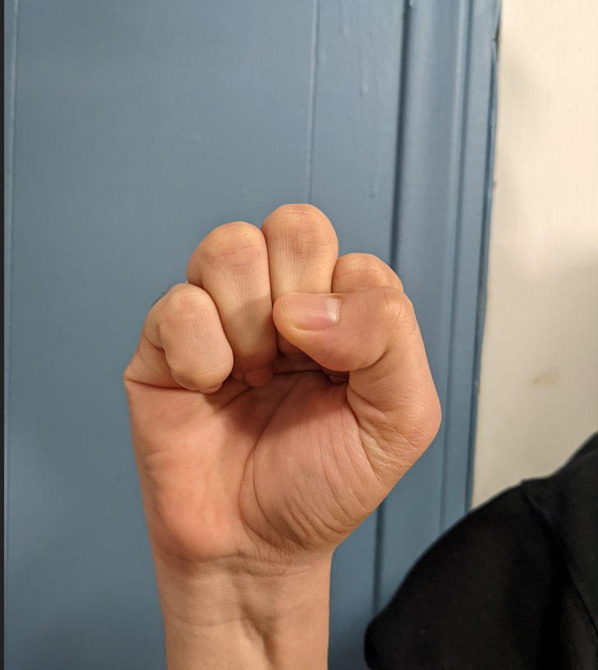
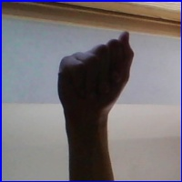
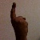
The data in our data sets are images of people performing the hand gestures that correspond to a letter in the ASL alphabet. Therefore, we have 26 different classes in our dataset.
Notes:
Examples of our data images.

Slide 6
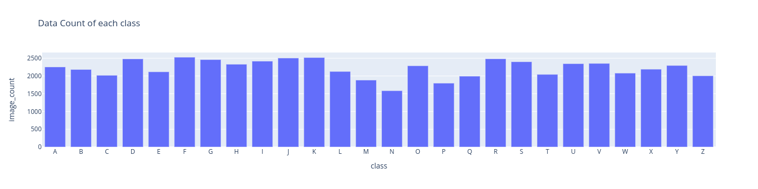
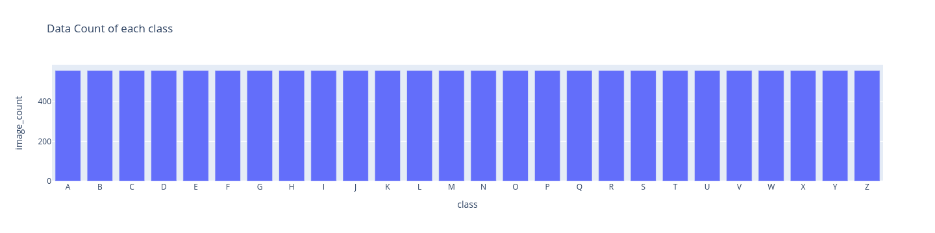
Final Data sets used
Training data set started with around 87k images but after removing any images that couldn’t make it pass our image pipeline we had around 52k images.
The testing data set was created from a combination of 3 datasets. We gave each data set a weight related to how good we believed it was and then randomly pick 555 images for each of our 26 classes.

Slide 7
Prepossessing Phase
General Pipeline
roi normalization (by mediapipe)
background normalization (by rembg)
skin normalization
channel normalization
resolution normalization
Data Augmentation (supplementing pipeline for training set)
Overfitting Risks
Notes:
Notes written elsewhere

Slide 8


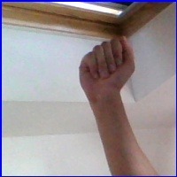
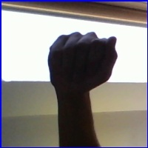
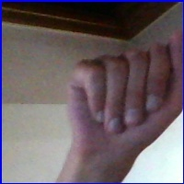
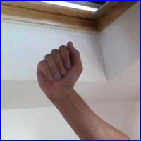
ASL Model - Is CNN strong enough?
Human CNN
1. Under different angles
2. Under different backgrounds
3. Under several different lighting conditions.

Slide 9
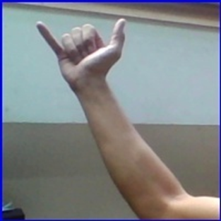
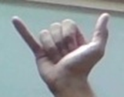
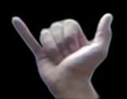
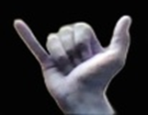
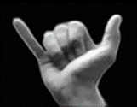
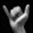
ASL Model - How we help CNN
Skin Color & Illumination, Background ➡ Image-Pipeline

Slide 10
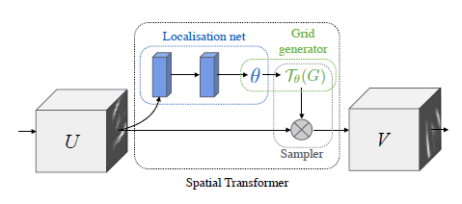
ASL Model - How we help CNN
2. Spatial Problem (rotation angles) ➡ Data Augmentation

Slide 11
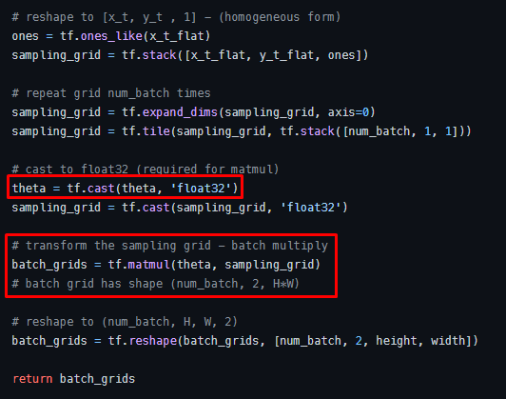
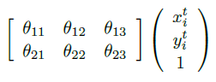
ASL Model - Spatial Transformer Layer

Slide 12
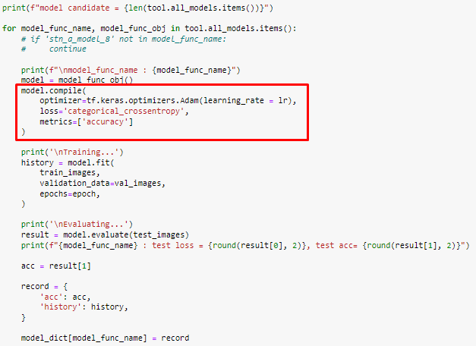
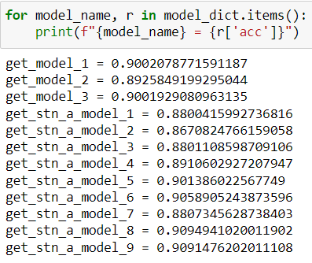
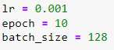
ASL Model - Model Structure Selection
Find out the best model structure for our Normal Model and STL Model

Slide 13
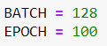
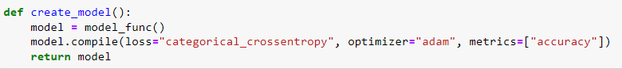
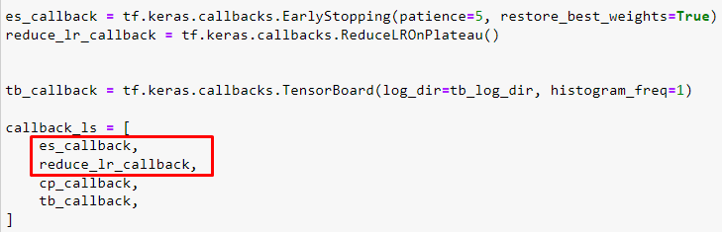
ASL Model - Training the Normal Model & the STL Model

Slide 14
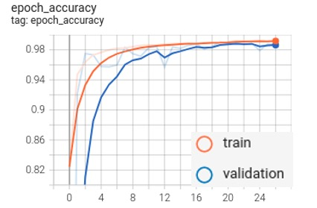
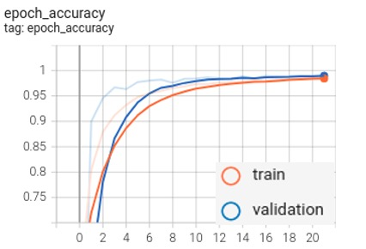
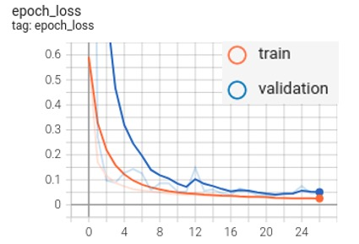
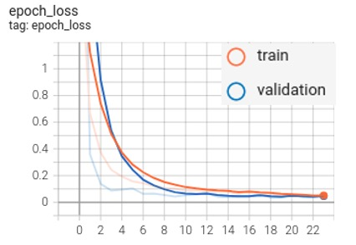
Results - Training & Validation Data
Normal Model - train: 99.1%, valid: 98.6%
STL Model - train: 98.7%, valid: 98.8%

Slide 15
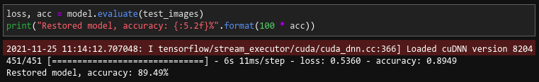
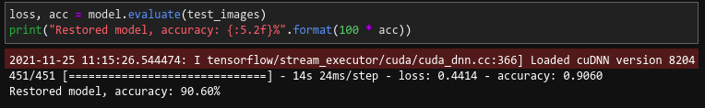
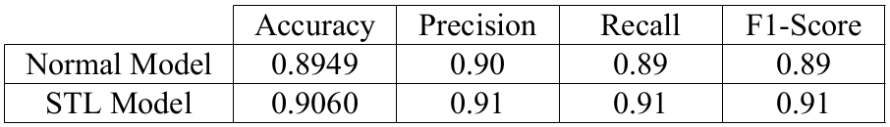
Results - Testing Data
Normal Model : 89.4%
STL Model: 90.6%

Slide 16
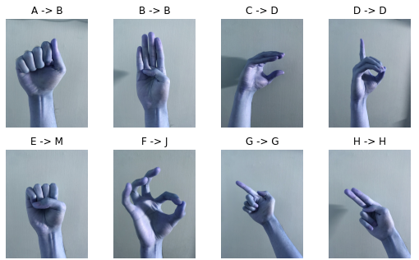
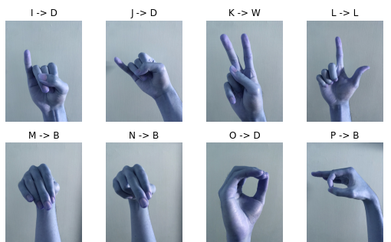
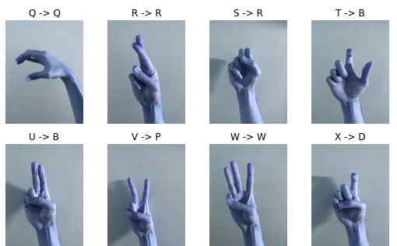
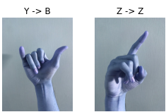
Result - Our Own Hands Data
Best Accuracy: 35%

Slide 17
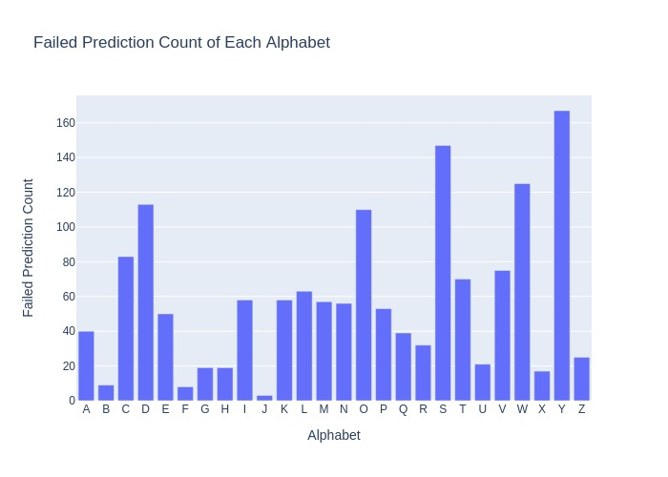
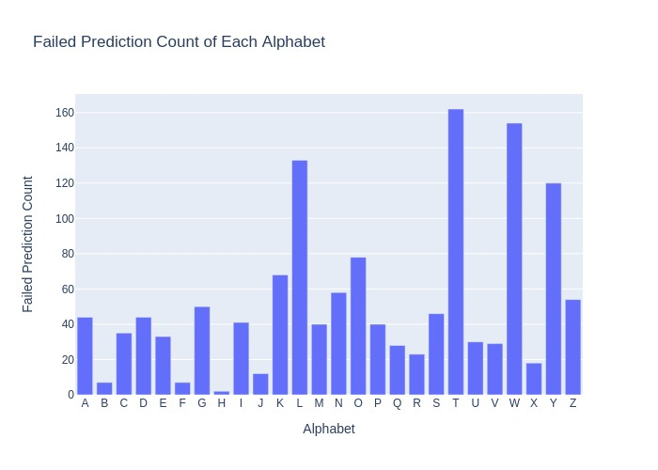
Result - Performance Analysis
Normal Model
STL Model

Slide 18
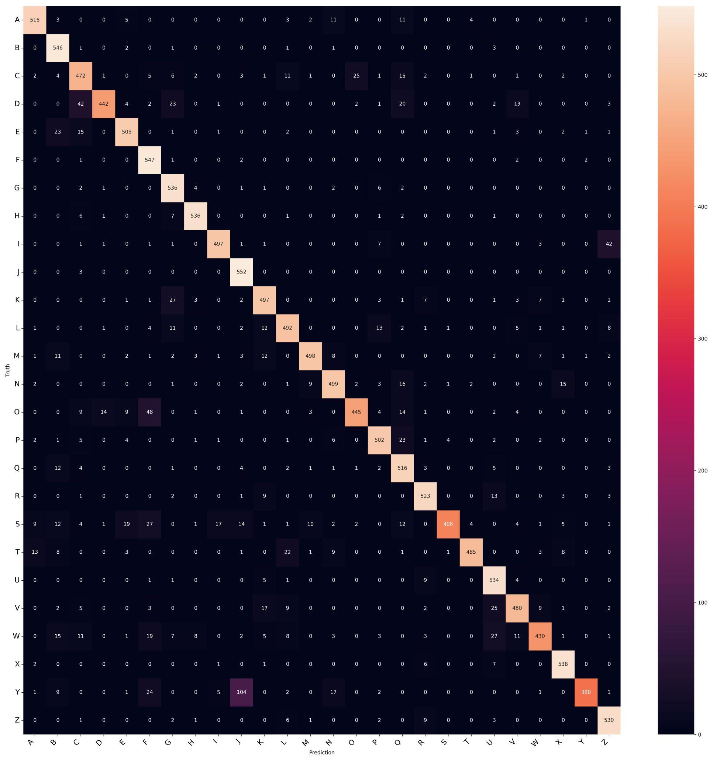
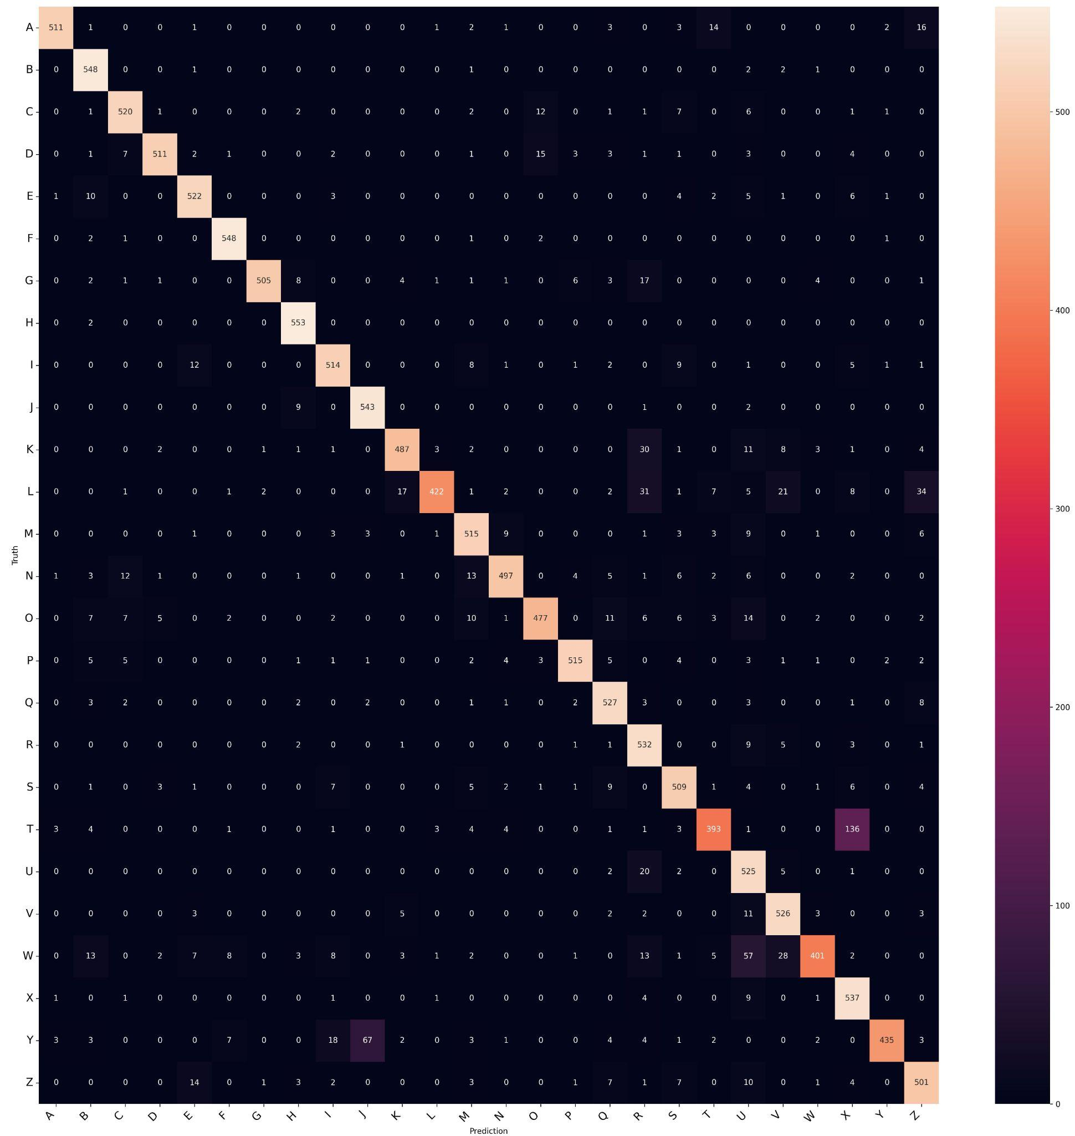
Result - Performance Analysis - Confusion Matrix Heat Map

Slide 19
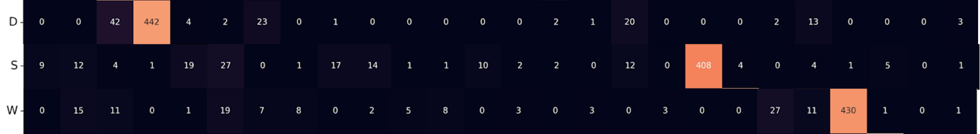
Result - Normal Model Confusion Matrix Heat Map
There are 5 alphabets which recall are <= 80%. They are D, O, S, W, Y.
The prediction of alphabet D, S and W are tent to be diverged.

Slide 20
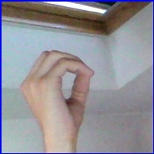
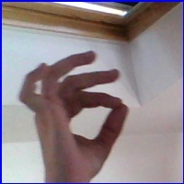
Result - Normal Model Confusion Matrix Heat Map
There are 5 alphabets which recall are <= 80%. They are D, O, S, W and Y.
Alphabet O is tent to be confused with alphabet F
TEST_O
TRAIN_F
🤔

Slide 21
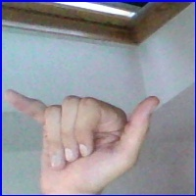

Result - Normal Model Confusion Matrix Heat Map
There are 5 alphabets which recall are <= 80%. They are D, O, S, W and Y.
Alphabet Y is tent to be confused with alphabet J
TEST_Y
TRAIN_J
🤔

Slide 22
Result - STL Model Confusion Matrix Heat Map
There are 4 alphabets which recall are <= 80%. They are L, T, W and Y.
Only the prediction of alphabet L is tent to be diverged.

Slide 23


Result - STL Model Confusion Matrix Heat Map
There are 4 alphabets which recall are <= 80%. They are L, T, W and Y.
Alphabet T is tent to be confused with alphabet X
TEST_T
TRAIN_X
🤔

Slide 24


Result - STL Model Confusion Matrix Heat Map
There are 4 alphabets which recall are <= 80%. They are L, T, W and Y.
Alphabet W is tent to be confused with alphabet U
TEST_W
TRAIN_U
🤔

Slide 25

Result - STL Model Confusion Matrix Heat Map
There are 4 alphabets which recall are <= 80%. They are L, T, W and Y.
Alphabet Y is tent to be confused with alphabet J
TEST_W
TRAIN_U
🤔

Slide 26
Conclusion - Cause of the Drawback
The issue is not the quantity of data but the quality; Either our training or testing data are too similar
The training dataset volume of 57k images are too few for training a general hand gesture recognition model
We do too much high constraint preprocessing in our image pipeline. Like we use the library of mediapipe and rembg. The noise in the original dataset might be a necessary factor for a robust model

Slide 27
Conclusion - Possible Improvement
Separate the dynamic symbols from the static symbols, such like the alphabet J and Z
According to the result of CMHM, the model is bad at distinguish the features between fingers. We can find other way to tune a weight set which is sensible to human fingers
Redesign the structure of Spatial Transformer or tune the parameters, to make the Spatial Transformer more fit to hand gestures instead of MNIST numbers

Slide 28
Q&A
Any questions?

